Slide 1
Analysis on Restaurants in Chennai
NAVIN KUMAR V

Slide 2
INTRODUCTION
This presentation explores the performance and customer satisfaction of restaurants using SQL-based analysis.
By examining restaurant ratings, features, pricing, and location data, we uncover key insights into the factors that drive success in the restaurant industry.
Our goal is to provide a data-driven perspective that highlights patterns, trends, and opportunities for optimizing restaurant operations and enhancing customer experiences.

Slide 3
OBJECTIVES
Evaluate Restaurant Performance:
Analyze restaurant ratings for both dining and delivery experiences to identify top-performing restaurants and those with improvement opportunities.
Understand Customer Preferences:
Examine which cuisines, features, and pricing models are most popular among customers, and how they influence restaurant ratings and customer satisfaction.
Location-Based Insights:
Investigate how the geographical area affects restaurant performance and customer behavior, highlighting high-performing areas and potential growth opportunities.

Slide 4
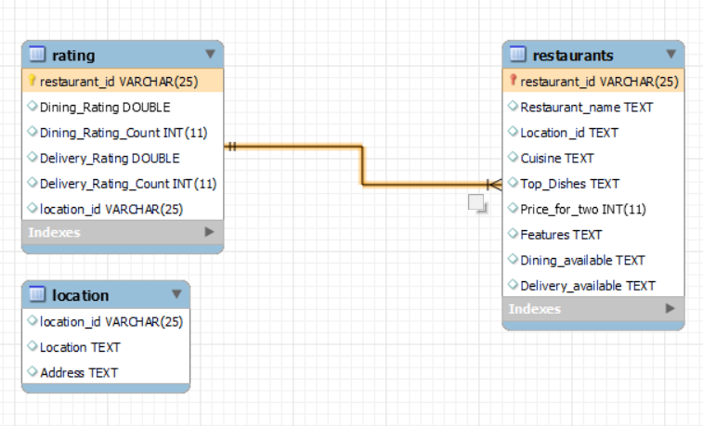
ER DIAGRAM

Slide 5
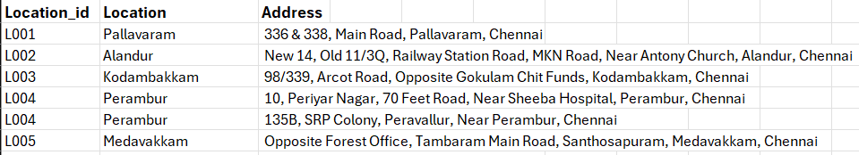
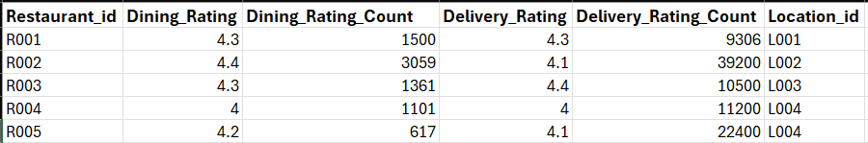
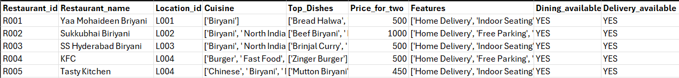
DATASET
LOCATION TABLE
…12032 Records
RATING TABLE
…12032 Records
RESTAURANTS TABLE
…12032 Records

Slide 6
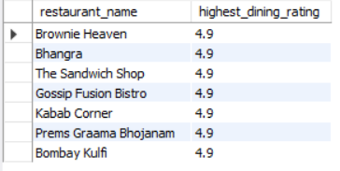
HIGHEST DINING RATING
SELECT restaurant_name, Dining_Rating AS highest_dining_rating FROM Restaurants r JOIN Rating rt ON r.Restaurant_id = rt.restaurant_id WHERE Dining_rating = (SELECT MAX(dining_rating) FROM rating);

Slide 7
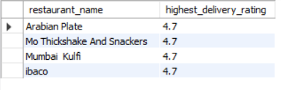
HIGHEST DELIVERY RATING
SELECT restaurant_name, Delivery_Rating AS highest_delivery_rating FROM Restaurants r JOIN Rating rt ON r.Restaurant_id = rt.restaurant_id WHERE Delivery_rating = (SELECT MAX(delivery_rating) FROM rating);

Slide 8
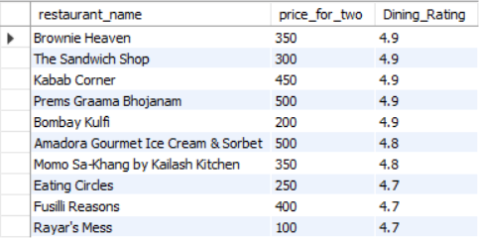
TOP AFFORDABLE RESTAURANTS
SELECT restaurant_name, price_for_two, Dining_Rating FROM Restaurants r JOIN Rating rt ON r.Restaurant_id = rt.restaurant_id WHERE price_for_two < 600 ORDER BY Dining_Rating DESC LIMIT 10;

Slide 9
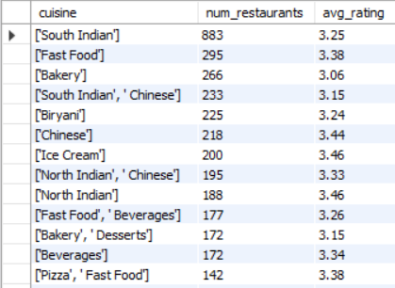
POPULAR CUISINES
SELECT cuisine, COUNT(*) AS num_restaurants, AVG(Dining_Rating) AS avg_rating FROM Restaurants r JOIN Rating rt ON r.Restaurant_id = rt.restaurant_id GROUP BY cuisine ORDER BY num_restaurants DESC;

Slide 10
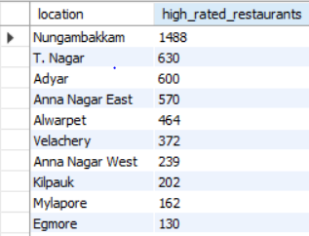
AREAS WITH MOST HIGH RATED RESTAURANTS
SELECT l.location, COUNT(*) AS high_rated_restaurants FROM Location l JOIN Restaurants r ON l.location_id = r.location_id JOIN Rating rt ON r.Restaurant_id = rt.restaurant_id WHERE Dining_Rating > 4.5 GROUP BY l.location ORDER BY high_rated_restaurants DESC;

Slide 11
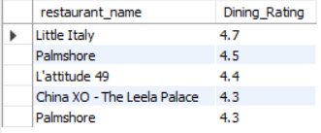
RESTAURANTS WITH “OUTDOOR SEATING” AND “BUFFET”
SELECT restaurant_name, Dining_Rating FROM Restaurants r JOIN Rating rt ON r.Restaurant_id = rt.restaurant_id WHERE features LIKE '%outdoor seating%' AND features LIKE '%buffet%’ ORDER BY Dining_Rating DESC LIMIT 5;

Slide 12
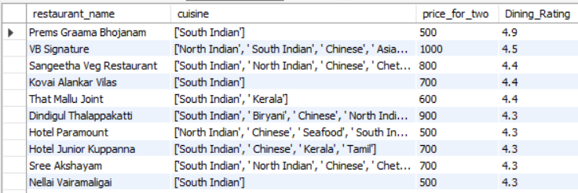
COMPARING RESTAURANTS WITH SIMILAR CUISINES AND PRICE RANGES
SELECT restaurant_name, cuisine, price_for_two, Dining_Rating FROM Restaurants r JOIN Rating rt ON r.Restaurant_id = rt.restaurant_id WHERE price_for_two BETWEEN 500 AND 1000 AND cuisine LIKE '%South Indian%’ ORDER BY Dining_Rating DESC;

Slide 13
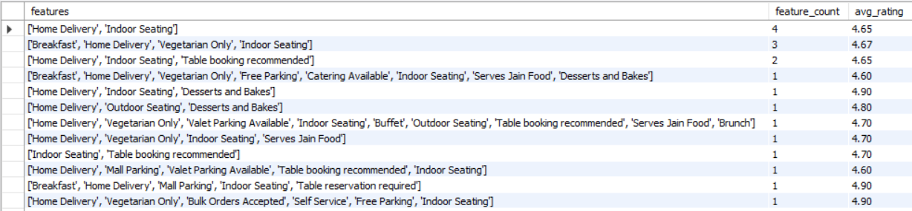
FEATURES THAT HIGH RATED RESTAURANTS HAVE
SELECT features, COUNT(*) AS feature_count, ROUND(AVG(Dining_Rating),2) AS avg_rating FROM Restaurants r JOIN Rating rt ON r.Restaurant_id = rt.restaurant_id WHERE Dining_Rating > 4.5 GROUP BY features ORDER BY feature_count DESC;

Slide 14
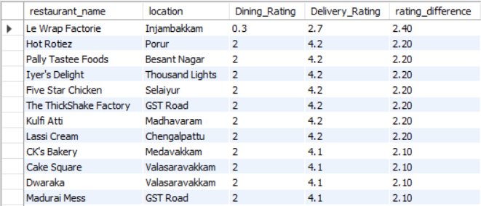
RESTAURANTS WHERE DELIVERY RATING EXCEEDS DINING RATING SIGNIFICANTLY
SELECT DISTINCT r.restaurant_name, l.location, rt.Dining_Rating, rt.Delivery_Rating,ROUND((rt.Delivery_Rating - rt.Dining_Rating),2) AS rating_difference FROM Restaurants r JOIN Rating rt ON r.Restaurant_id = rt.restaurant_id JOIN Location l ON r.location_id = l.location_id WHERE (rt.Delivery_Rating - rt.Dining_Rating) > 1.5 ORDER BY rating_difference DESC;

Slide 15
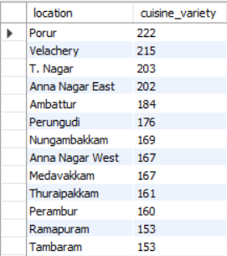
MOST CUISINE VARIETIES IN AN AREA
SELECT l.location, COUNT(DISTINCT cuisine) AS cuisine_variety FROM Location l JOIN Restaurants r ON l.location_id = r.location_id GROUP BY l.location ORDER BY cuisine_variety DESC;

